Slide 1
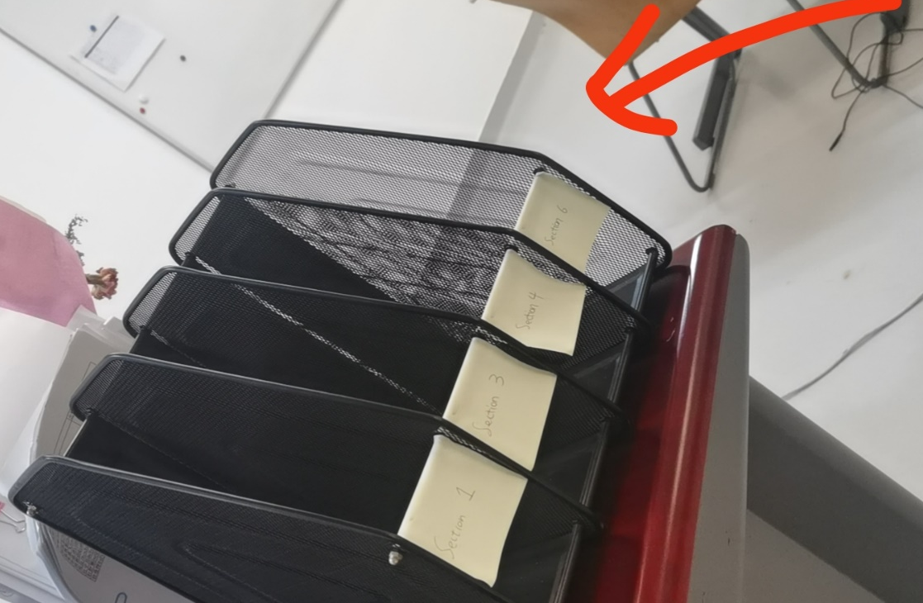
说明：
【补考】 每学期有一次补考机会，需要提供相关证明 没有其他补考机会，如缺考，按零分处理 【缺勤】
无故缺勤3次以上，期末*0.9；请假的同学请提前在企业微信和我说。
【作业】
作业打印出来放在
不收电子版了！~

Slide 2
Lecture 1
Relationship Between
Two Quantitative Variables

Slide 3
When we understand the relationship between two variable, we can use the value of one variable to help us make predictions about the other variable.
relationships between two quantitative variable

Slide 4
Learning Targets
Distinguish between explanatory and response variables for quantitative data.
Make a scatterplot to display the relationship between two quantitative variables.
Describe a scatterplot.
Interpret the correlation and the correlation coefficient.
Correlation and Causation.

Slide 5
Bivariate Data
Bivariate data: data with two variables
Example:
Student # | Height(cm) | Weight(kg)
1 | 160 | 58
2 | 171 | 60
3 | 165 | 60
… | … | …
100 | 180 | 70

Slide 6
Displaying Relationships: Scatterplots
Definition:
A scatterplot shows the relationship between two quantitative variables.
The values of one variable appear on the horizontal axis, and the values of the other variable appear on the vertical axis.

Slide 7
Bivariate Data
Bivariate data: data with two variables
Example:
Student # | Height(cm) | Weight(kg)
1 | 160 | 58
2 | 171 | 60
3 | 165 | 60
… | … | …
100 | 180 | 70

Slide 8
Topics
Explanatory and response variable
Describing scatterplots
The correlation coefficient (r)
Correlation and causation

Slide 9
Topics
Explanatory and response variable
Describing scatterplots
The correlation coefficient (r)
Correlation and causation

Slide 10
Explanatory and Response Variables
It is easiest to identify explanatory and response variables when we initially specify the values of one variable to see how it affects another variable.
For instance, to study the effect of alcohol on body temperature, researchers gave several different amounts of alcohol to mice. Then they measured the change in each mouse’s body temperature 15 minutes later. In this case, amount of alcohol is the explanatory variable, and change in body temperature is the response variable.
When we do not specify the values of either variable before collecting the data, there may or may not be a clear explanatory variable.

Slide 11
Using this data from San Antonio, TX, we will explore whether there is a relationship between neighborhood income and access to organic items at local grocery stores.
Zip Code | Store Location | Average Household Income | Number of Organic Vegetables Offered
78204 | South Flores | $71,186 | 36
78207 | N. Rosillo st | $34,234 | 4
78204 | Nogalitos st | $71,186 | 28
78201 | Frederickburg rd | $48,760 | 31
78212 | Olmos | $78,096 | 78
78202 | N New Braunfels | $40,506 | 14
78237 | Castroville | $38,166 | 12
78228 | Culebra rd | $50,398 | 18
78227 | Marbach rd | $49,437 | 38
78240 | Babcock rd | $66,073 | 84
78230 | Wurzbach rd | $86,566 | 61
78251 | W Loop 1604 N | $78,176 | 56

Slide 12
Explanatory and Response Variables
Explanatory (independent) variable: the variable that predicts, explains, or influences a trend in the response variable. This is the x-variable.

Slide 13
Explanatory and Response Variables
Explanatory (independent) variable: the variable that predicts, explains, or influences a trend in the response variable. This is the x-variable.
Response (dependent) variable: the measured outcome. Responds to trends in the explanatory variable. This is the
y-variable.

Slide 14
Explanatory and Response Variables
Average Household Income | Organic Vegetables Offered
$71,186 | 36
$34,234 | 4
$71,186 | 28
$48,760 | 31
$78,096 | 78
$40,506 | 14
$38,166 | 12
$50,398 | 18
$49,437 | 38
$66,073 | 84
$86,566 | 61
$78,176 | 56
Explanatory (independent) variable: the variable that predicts, explains, or influences a trend in the response variable. This is the x-variable.
Response (dependent) variable: the measured outcome. Responds to trends in the explanatory variable. This is the
y-variable.

Slide 15
Explanatory and Response Variables
explains
responds
Average Household Income | Organic Vegetables Offered
$71,186 | 36
$34,234 | 4
$71,186 | 28
$48,760 | 31
$78,096 | 78
$40,506 | 14
$38,166 | 12
$50,398 | 18
$49,437 | 38
$66,073 | 84
$86,566 | 61
$78,176 | 56
Explanatory (independent) variable: the variable that predicts, explains, or influences a trend in the response variable. This is the x-variable.
Response (dependent) variable: the measured outcome. Responds to trends in the explanatory variable. This is the
y-variable.

Slide 16
Explanatory and Response Variables
explains
responds
Average Household Income (x) | Organic Vegetables Offered
$71,186 | 36
$34,234 | 4
$71,186 | 28
$48,760 | 31
$78,096 | 78
$40,506 | 14
$38,166 | 12
$50,398 | 18
$49,437 | 38
$66,073 | 84
$86,566 | 61
$78,176 | 56
Explanatory (independent) variable: the variable that predicts, explains, or influences a trend in the response variable. This is the x-variable.
Response (dependent) variable: the measured outcome. Responds to trends in the explanatory variable. This is the
y-variable.

Slide 17
Explanatory and Response Variables
explains
responds
Average Household Income (x) | Organic Vegetables Offered (y)
$71,186 | 36
$34,234 | 4
$71,186 | 28
$48,760 | 31
$78,096 | 78
$40,506 | 14
$38,166 | 12
$50,398 | 18
$49,437 | 38
$66,073 | 84
$86,566 | 61
$78,176 | 56
Explanatory (independent) variable: the variable that predicts, explains, or influences a trend in the response variable. This is the x-variable.
Response (dependent) variable: the measured outcome. Responds to trends in the explanatory variable. This is the
y-variable.

Slide 18
Explanatory and Response Variables
explains
responds
Average Household Income (x) | Organic Vegetables Offered (y)
$71,186 | 36
$34,234 | 4
$71,186 | 28
$48,760 | 31
$78,096 | 78
$40,506 | 14
$38,166 | 12
$50,398 | 18
$49,437 | 38
$66,073 | 84
$86,566 | 61
$78,176 | 56
The explanatory variable is the “Average Household Income” because we are investigating how well it predicts and relates to the measured outcome: the number of organic vegetables offered at the local supermarket.
The response variable is the “Organic Vegetables Offered” because it is the “outcome” we are measuring, based on average household income.
Explanatory (independent) variable: the variable that predicts, explains, or influences a trend in the response variable. This is the x-variable.
Response (dependent) variable: the measured outcome. Responds to trends in the explanatory variable. This is the
y-variable.

Slide 19
Topics
Explanatory and response variable
Describing scatterplots
The correlation coefficient (r)
Correlation and causation

Slide 20
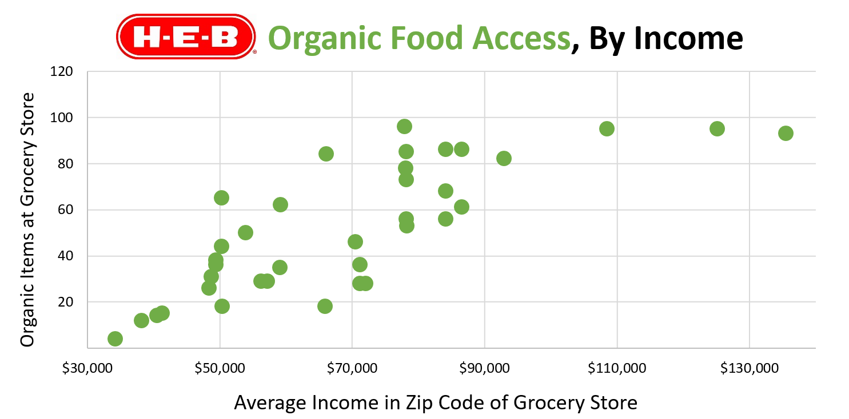
Scatterplot

Slide 21
Describing Scatterplots: Direction
Correlation: measures how two variables are related.

Slide 22
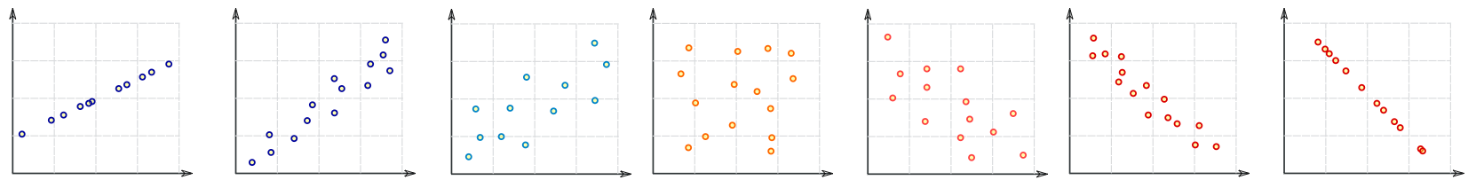
Describing Scatterplots: Direction
Describing Scatterplots
Perfect Positive Correlation
Strong Positive Correlation
Weak Positive Correlation
Weak Negative Correlation
Strong Negative Correlation
Perfect Negative Correlation
No
Correlation

Slide 23
Describing Scatterplots: Direction
Perfect Positive Correlation
Strong Positive Correlation
Weak Positive Correlation
Weak Negative Correlation
Strong Negative Correlation
Perfect Negative Correlation
No
Correlation
Positive correlations: as the x values increase, the y values also tend to increase.

Slide 24
Describing Scatterplots: Direction
Perfect Positive Correlation
Strong Positive Correlation
Weak Positive Correlation
Weak Negative Correlation
Strong Negative Correlation
Perfect Negative Correlation
No
Correlation
x increases
Positive correlations: as the x values increase, the y values also tend to increase.

Slide 25
Describing Scatterplots: Direction
Graphic inspired by mathisfun.com
Perfect Positive Correlation
Strong Positive Correlation
Weak Positive Correlation
Weak Negative Correlation
Strong Negative Correlation
Perfect Negative Correlation
No
Correlation
y
x increases
Positive correlations: as the x values increase, the y values also tend to increase.

Slide 26
Describing Scatterplots: Direction
Graphic inspired by mathisfun.com
Perfect Positive Correlation
Strong Positive Correlation
Weak Positive Correlation
Weak Negative Correlation
Strong Negative Correlation
Perfect Negative Correlation
No
Correlation
y
y
y
x increases
x increases
x increases
Positive correlations: as the x values increase, the y values also tend to increase.

Slide 27
Describing Scatterplots: Direction
Graphic inspired by mathisfun.com
Perfect Positive Correlation
Strong Positive Correlation
Weak Positive Correlation
Weak Negative Correlation
Strong Negative Correlation
Perfect Negative Correlation
No
Correlation
y
y
y
x increases
x increases
x increases
Positive correlations: as the x values increase, the y values also tend to increase.
Negative correlations: as the x values increase, the y values tend to decrease.

Slide 28
Describing Scatterplots: Direction
Graphic inspired by mathisfun.com
Perfect Positive Correlation
Strong Positive Correlation
Weak Positive Correlation
Weak Negative Correlation
Strong Negative Correlation
Perfect Negative Correlation
No
Correlation
x increases
y
y
y
x increases
x increases
x increases
Positive correlations: as the x values increase, the y values also tend to increase.
Negative correlations: as the x values increase, the y values tend to decrease.

Slide 29
Describing Scatterplots: Direction
Graphic inspired by mathisfun.com
Perfect Positive Correlation
Strong Positive Correlation
Weak Positive Correlation
Weak Negative Correlation
Strong Negative Correlation
Perfect Negative Correlation
No
Correlation
x increases
y
y
y
y
x increases
x increases
x increases
Positive correlations: as the x values increase, the y values also tend to increase.
Negative correlations: as the x values increase, the y values tend to decrease.

Slide 30
Describing Scatterplots: Direction
Graphic inspired by mathisfun.com
Perfect Positive Correlation
Strong Positive Correlation
Weak Positive Correlation
Weak Negative Correlation
Strong Negative Correlation
Perfect Negative Correlation
No
Correlation
x increases
x increases
x increases
y
y
y
y
y
y
x increases
x increases
x increases
Positive correlations: as the x values increase, the y values also tend to increase.
Negative correlations: as the x values increase, the y values tend to decrease.

Slide 31
Describing Scatterplots: Direction
Graphic inspired by mathisfun.com
Perfect Positive Correlation
Strong Positive Correlation
Weak Positive Correlation
Weak Negative Correlation
Strong Negative Correlation
Perfect Negative Correlation
No
Correlation
x increases
x increases
x increases
y
y
y
y
y
y
x increases
x increases
x increases
Positive correlations: as the x values increase, the y values also tend to increase.
Negative correlations: as the x values increase, the y values tend to decrease.
Notes:
Positive correlation： positive slope

Slide 32
Describing Scatterplots: Direction
Graphic inspired by mathisfun.com
Perfect Positive Correlation
Strong Positive Correlation
Weak Positive Correlation
Weak Negative Correlation
Strong Negative Correlation
Perfect Negative Correlation
No
Correlation
(+)
(+)
(+)
x increases
x increases
x increases
y
y
y
y
y
y
x increases
x increases
x increases
Positive correlations: as the x values increase, the y values also tend to increase.
Negative correlations: as the x values increase, the y values tend to decrease.

Slide 33
Describing Scatterplots: Direction
Graphic inspired by mathisfun.com
Perfect Positive Correlation
Strong Positive Correlation
Weak Positive Correlation
Weak Negative Correlation
Strong Negative Correlation
Perfect Negative Correlation
No
Correlation
(+)
(+)
(+)
x increases
x increases
x increases
-
y
-
y
-
y
y
y
y
( )
( )
( )
x increases
x increases
x increases
Positive correlations: as the x values increase, the y values also tend to increase.
Negative correlations: as the x values increase, the y values tend to decrease.

Slide 34
Describing Scatterplots
Least Squares Regression Line (LSRL): a straight line that roughly puts half of your data above it and half below it.
more formal definition coming next lesson

Slide 35
Describing Scatterplots
Graphic inspired by mathisfun.com
Perfect Positive Correlation
Strong Positive Correlation
Weak Positive Correlation
Weak Negative Correlation
Strong Negative Correlation
Perfect Negative Correlation
No
Correlation

Slide 36
Describing Scatterplots
Graphic inspired by mathisfun.com
Perfect Positive Correlation
Strong Positive Correlation
Weak Positive Correlation
Weak Negative Correlation
Strong Negative Correlation
Perfect Negative Correlation
No
Correlation

Slide 37
Describing Scatterplots
Graphic inspired by mathisfun.com
Perfect Positive Correlation
Strong Positive Correlation
Weak Positive Correlation
Weak Negative Correlation
Strong Negative Correlation
Perfect Negative Correlation
No
Correlation
Strong correlations: data is close to the LSRL

Slide 38
Describing Scatterplots
Graphic inspired by mathisfun.com
Perfect Positive Correlation
Strong Positive Correlation
Weak Positive Correlation
Weak Negative Correlation
Strong Negative Correlation
Perfect Negative Correlation
No
Correlation
Strong correlations: data is close to the LSRL

Slide 39
Describing Scatterplots
Graphic inspired by mathisfun.com
Perfect Positive Correlation
Strong Positive Correlation
Weak Positive Correlation
Weak Negative Correlation
Strong Negative Correlation
Perfect Negative Correlation
No
Correlation
Strong correlations: data is close to the LSRL
The LSRL is a good model for the data
If you used the LSRL to predict new data, you would make close predictions

Slide 40
Describing Scatterplots
Graphic inspired by mathisfun.com
Perfect Positive Correlation
Strong Positive Correlation
Weak Positive Correlation
Weak Negative Correlation
Strong Negative Correlation
Perfect Negative Correlation
No
Correlation
Weak correlations: data is far from the LSRL

Slide 41
Describing Scatterplots
Graphic inspired by mathisfun.com
Perfect Positive Correlation
Strong Positive Correlation
Weak Positive Correlation
Weak Negative Correlation
Strong Negative Correlation
Perfect Negative Correlation
No
Correlation
Weak correlations: data is far from the LSRL
\

Slide 42

Describing Scatterplots
Graphic inspired by mathisfun.com
Perfect Positive Correlation
Strong Positive Correlation
Weak Positive Correlation
Weak Negative Correlation
Strong Negative Correlation
Perfect Negative Correlation
No
Correlation
Weak correlations: data is far from the LSRL
The LSRL is a ‘meh’ model for the data
If you used the LSRL to predict new data, you may be quite a bit off

Slide 43
Scatterplot

Slide 44
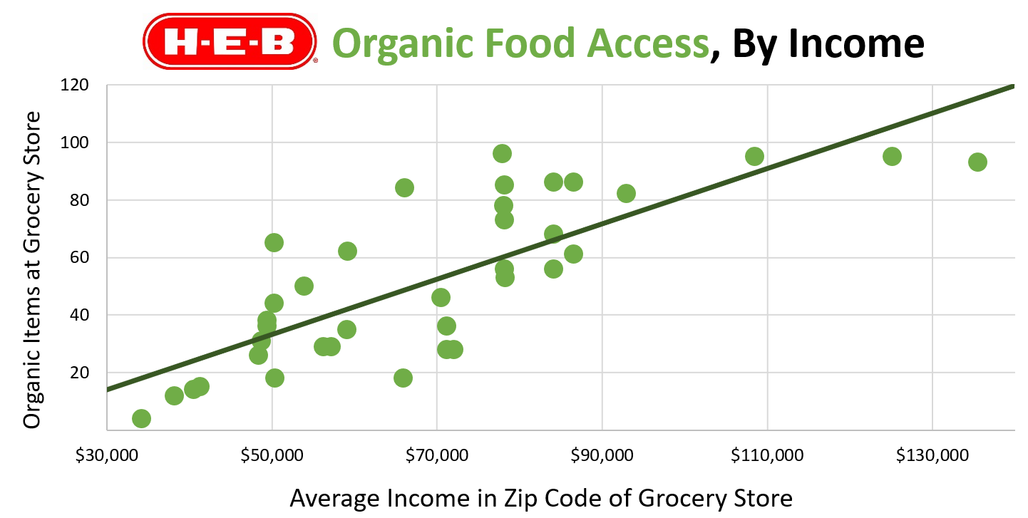
Scatterplot with LSRL

Slide 45
Scatterplot with LSRL
As x increases…

Slide 46
Scatterplot with LSRL
y also increases
As x increases…

Slide 47
Scatterplot with LSRL
y also increases
Direction
Positive
As x increases…

Slide 48
Scatterplot with LSRL
y also increases
Direction
Positive
As average household income increases…

Slide 49
Scatterplot with LSRL
Organic food options increase
Direction
Positive
As average household income increases…

Slide 50
Scatterplot with LSRL

Slide 51
Scatterplot with LSRL

Slide 52
Scatterplot with LSRL
Strength
Moderate

Slide 53
Scatterplot with LSRL
Moderately strong:
income is a moderately good predictor of organic options.

Slide 54
Scatterplot with LSRL
Moderately strong: if a new store opened, our model could provide a moderately close prediction of its organic offerings based on neighborhood income.

Slide 55
Describe the relationship…

Slide 56
C
S
O
C
S
One Variable Data:
Dotplots, Stemplots, Histograms, Boxplots

Slide 57
C
S
O
C
S
C
D
O
F
S
One Variable Data:
Dotplots, Stemplots, Histograms, Boxplots
Two Variable Data:
Scatterplots

Slide 58
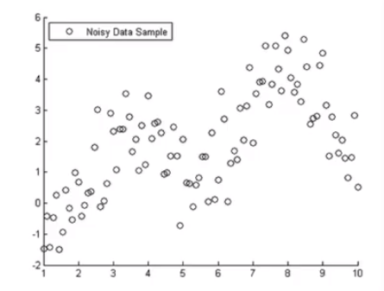
C – Context
D – Direction (positive/negative)
O – Outliers
F – Form (linear/non-linear)
S – Strength (strong/moderate/weak)

Slide 59
Describe the relationship…

Slide 60
Describe the relationship…
Context: Organic veggies and average income

Slide 61
Describe the relationship…
Context: Organic veggies and average income
Direction: Positive

Slide 62
Describe the relationship…
Context: Organic veggies and average income
Direction: Positive
Outliers: No outliers

Slide 63
Describe the relationship…
Context: Organic veggies and average income
Direction: Positive
Outliers: No outliers
Form: Linear

Slide 64
Describe the relationship…
Context: Organic veggies and average income
Direction: Positive
Outliers: No outliers
Form: Linear
Strength: Moderate

Slide 65
Put it all together:
The relationship between average household income and the number of organic vegetables offered at local stores appears to be linear, positive, and moderately strong. There do not appear to be any outliers.

Slide 66
Context
Put it all together:
The relationship between average household income and the number of organic vegetables offered at local stores appears to be linear, positive, and moderately strong. There do not appear to be any outliers.
Form
Direction
Strength
Outliers

Slide 67
Topics
Explanatory and response variable
Describing scatterplots
The correlation coefficient (r)
Correlation and causation

Slide 68
The Correlation Coefficient
Perfect Positive Correlation
Strong Positive Correlation
Weak Positive Correlation
Weak Negative Correlation
Strong Negative Correlation
Perfect Negative Correlation
No
Correlation
Correlation Coefficient (r): A number between -1 and 1 (inclusive) that tells you the strength and direction of a correlation.

Slide 69
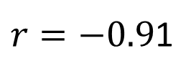






Perfect Positive Correlation
Strong Positive Correlation
Weak Positive Correlation
Weak Negative Correlation
Strong Negative Correlation
Perfect Negative Correlation
No
Correlation
$$r=1$$
$$r=0.91$$
$$r=0.48$$
$$r=0$$
$$r=−0.48$$
$r=−0.9$1
$$r=−1$$
Correlation Coefficient (r): A number between -1 and 1 that tells you the strength and direction of a correlation.

Slide 70
Guide to r values
Strength:
r close to 0 → weak correlation
r close to -1, 1 → strong correlation
Direction:
Negative r value → negative correlation
Positive r value → positive correlation

Slide 71
Scatterplot with LSRL

Slide 72
Lecture 2
Relationship Between
Two Quantitative Variables (ctns)

Slide 73
Topics
Explanatory and response variable
Describing scatterplots
The correlation coefficient (r)
Correlation and causation

Slide 74
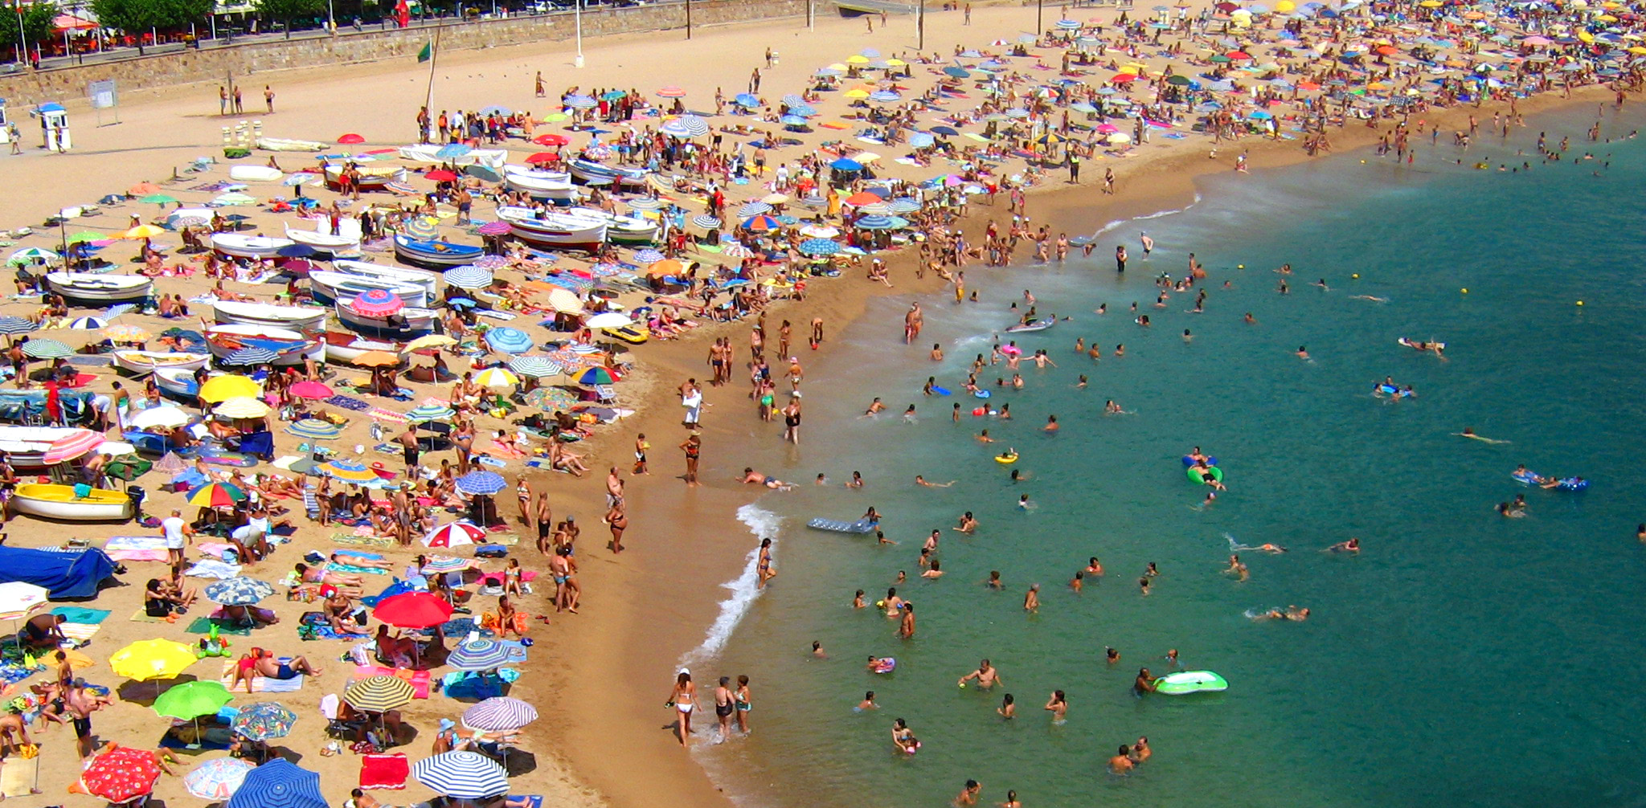
A statistician goes to a beach…
Example inspired by Ionica Smeets: https://www.youtube.com/watch?v=8B271L3NtAw

Slide 75
A statistician goes to a beach…
From 1994-2020, she collected three pieces of data each summer
The average temperature
The amount of ice cream sold at the beach shop
The amount of drownings
Example inspired by Ionica Smeets: https://www.youtube.com/watch?v=8B271L3NtAw

Slide 76
Discussion

Slide 77
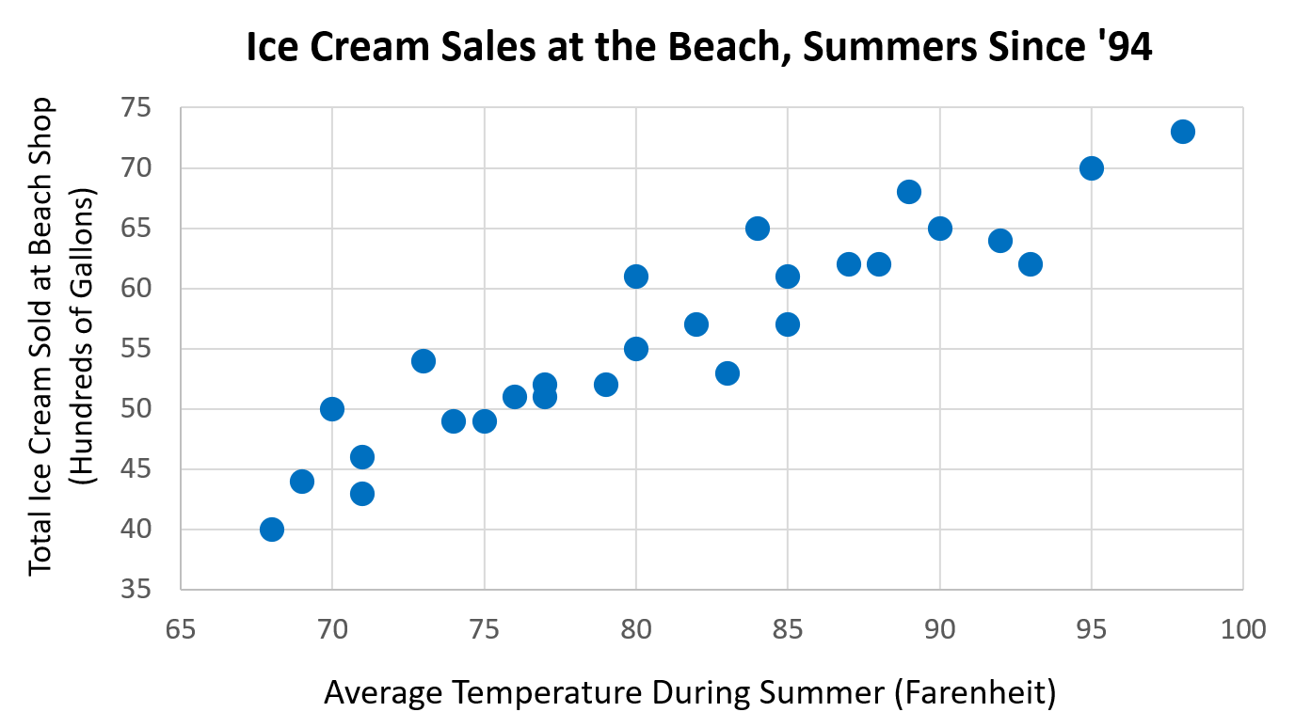
A
Example inspired by Ionica Smeets: https://www.youtube.com/watch?v=8B271L3NtAw

Slide 78
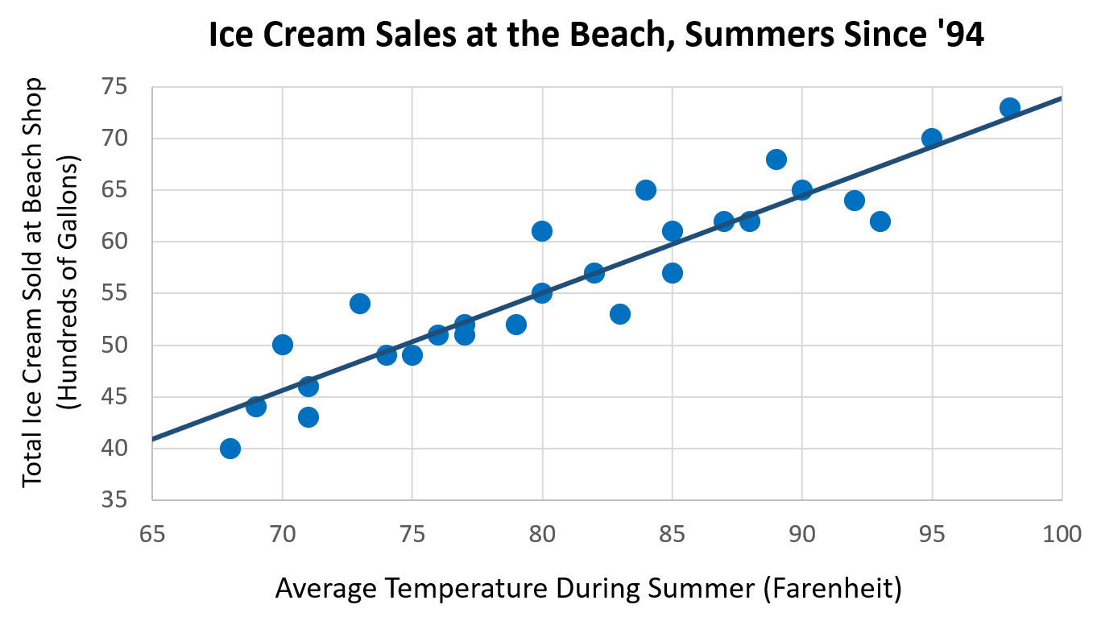
A
Example inspired by Ionica Smeets: https://www.youtube.com/watch?v=8B271L3NtAw

Slide 79
A
A) Discussion Question: Describe the relationship between temperature and ice cream sales. Does this relationship make sense? Why or why not?
Example inspired by Ionica Smeets: https://www.youtube.com/watch?v=8B271L3NtAw

Slide 80
A
A) Discussion Question: Describe the relationship between temperature and ice cream sales. Does this relationship make sense? Why or why not?
The relationship between average temperature and ice cream sales appears to be linear, positive and strong. There do not appear to be any outliers.
This relationship makes sense:
People tend to crave a cool treat when temperatures are high. They will not want ice cream as much when temperatures are low.
Example inspired by Ionica Smeets: https://www.youtube.com/watch?v=8B271L3NtAw

Slide 81
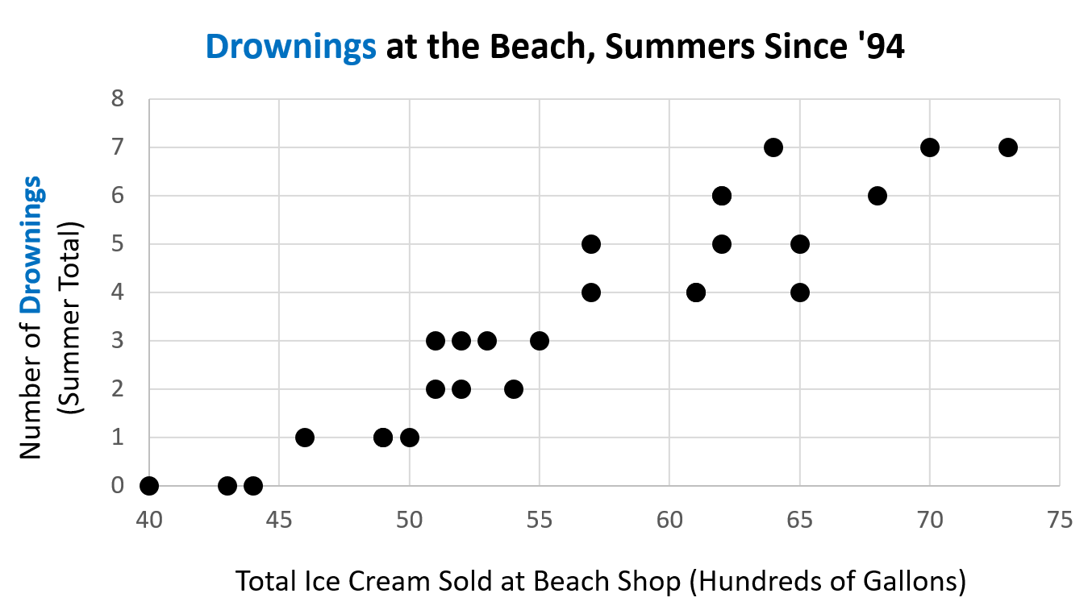
B
Example inspired by Ionica Smeets: https://www.youtube.com/watch?v=8B271L3NtAw

Slide 82
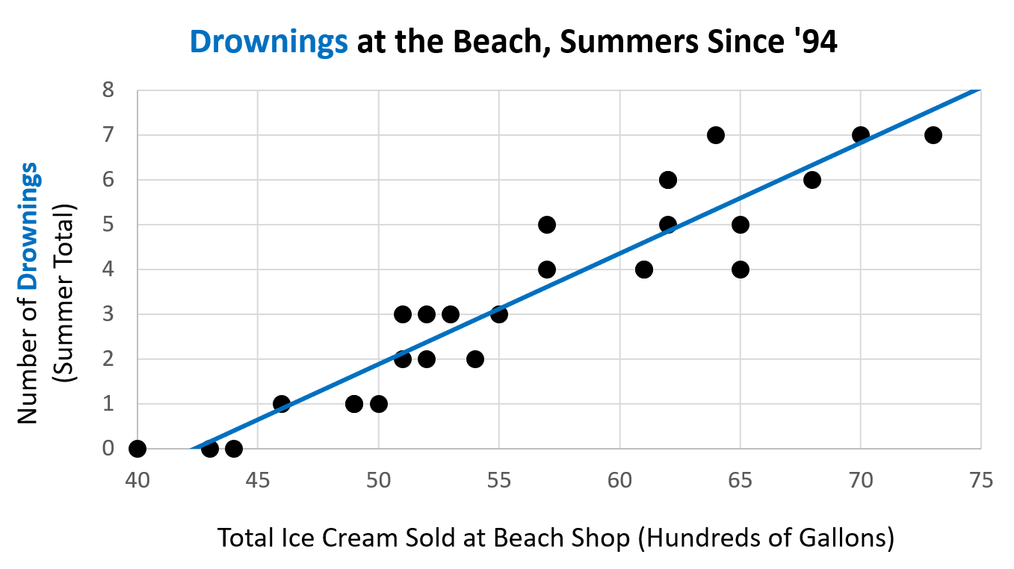
B
Example inspired by Ionica Smeets: https://www.youtube.com/watch?v=8B271L3NtAw

Slide 83
B
B) Discussion Question: Describe the relationship between ice cream sales and drownings. Does this relationship make sense? Why or why not?
Example inspired by Ionica Smeets: https://www.youtube.com/watch?v=8B271L3NtAw

Slide 84
B
B) Discussion Question: Describe the relationship between ice cream sales and drownings. Does this relationship make sense? Why or why not?
The relationship between ice cream sales and drownings per summer appears to be linear, positive and moderately strong. There do not appear to be any outliers.
Example inspired by Ionica Smeets: https://www.youtube.com/watch?v=8B271L3NtAw

Slide 85
B

Slide 86

B
WE MUST BAN ICE CREAM AT THE BEACH!!!

Slide 87
B
Does ice cream really cause people to drown?

Slide 88
B
Does ice cream really cause people to drown?

Slide 89
B

Slide 90

B

Slide 91
B
As temp rises…

Slide 92
B
As temp rises…
More people buy ice cream

Slide 93
B
As temp rises…
More people swim and, unfortunately, drown
More people buy ice cream

Slide 94
B
Ice cream sales do not cause drownings. The underlying variable of temperature is to blame here: as the summer gets hotter, more people buy ice cream and simultaneously, more people go swimming and (unfortunately) drown.
As temp rises…
More people swim and, unfortunately, drown
More people buy ice cream

Slide 95
There is an underlying third variable, temperature, that causes ice cream sales and drownings to coincide.
Ice cream sales and drownings are correlated but do not cause one another.

Slide 96
Correlation ≠ Causation

Slide 97
Sometimes, correlations…
Have an underlying cause (3rd variable)
Cause one another, but not in assumed direction
Are completely random, with no apparent cause

Slide 98
Correlation Coefficient

Slide 99
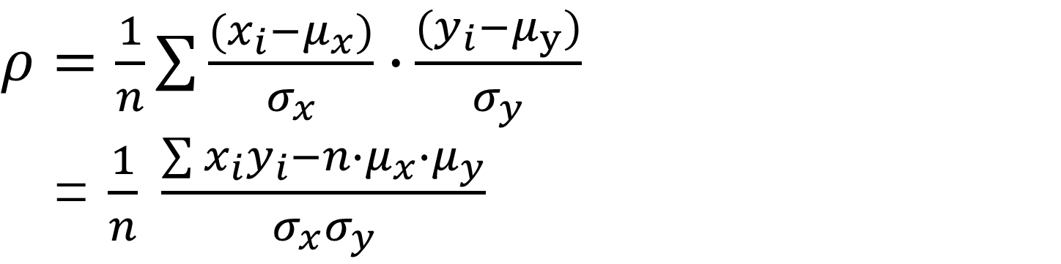
Population Correlation coefficient
$ρ=\frac{1}{n}\sum{\frac{(x_{i}−μ_{x})}{σ_{x}}∙}\frac{(y_{i}−μ_{y})}{σ_{y}}$
= $\frac{1}{n} \frac{\sum{x_{i}y_{i}−n∙μ_{x}∙μ_{y}}}{σ_{x}σ_{y}}$

Slide 100

Pearson’s Sample Correlation coefficient
$$r=\frac{{s_{xy}}^{2}}{s_{x}s_{y}}$$
$$=\frac{\sum{(x_{i}−\overline{x})(y_{i}−\overline{y})}}{n−1} ∙\frac{1}{s_{x}s_{y}}$$
= $\frac{1}{n−1}\sum{\frac{(x_{i}−\overline{x})}{s_{x}}∙}\frac{(y_{i}−\overline{y})}{s_{y}}$
= $\frac{1}{n−1}∙\frac{\sum{x_{i}y_{i}−n∙\overline{x}∙\overline{y}}}{s_{x}s_{y}}$

Slide 101
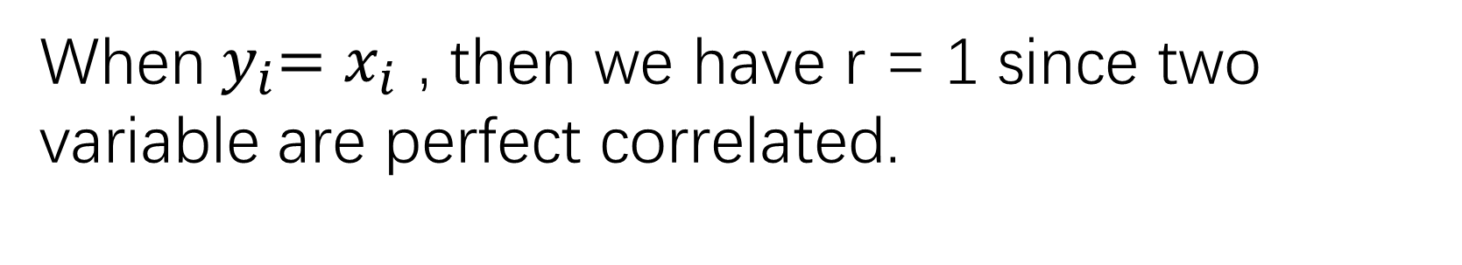
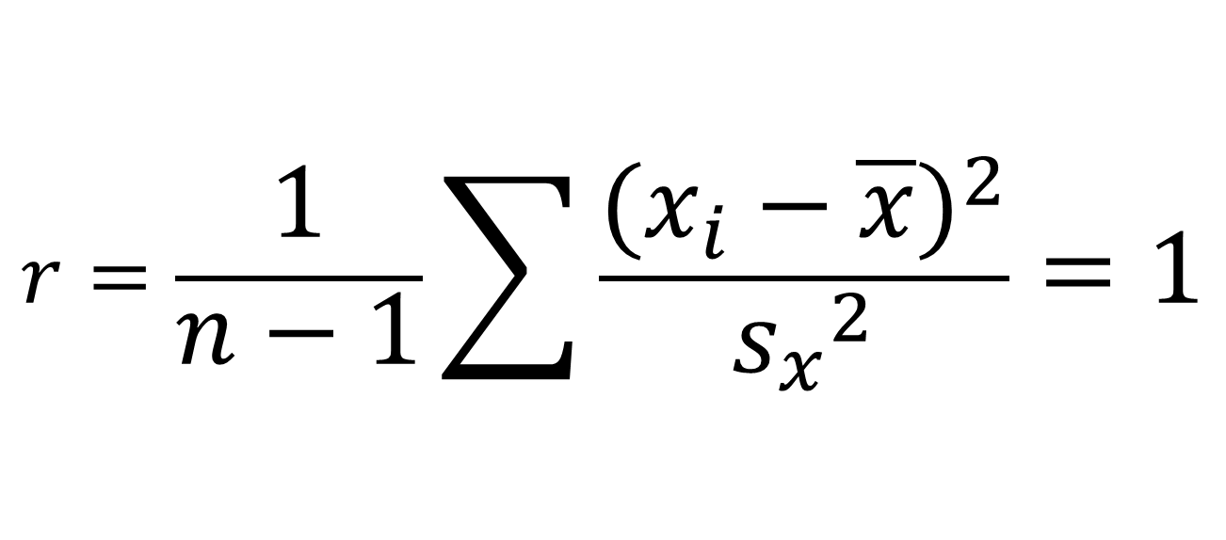
Pearson’s Sample Correlation coefficient
When${ y}_{i}=x_{i}$ , then we have r = 1 since two variable are perfect correlated.
$$r=\frac{1}{n−1}\sum{\frac{{(x_{i}−\overline{x})}^{2}}{{s_{x}}^{2}}}=1$$

Slide 102
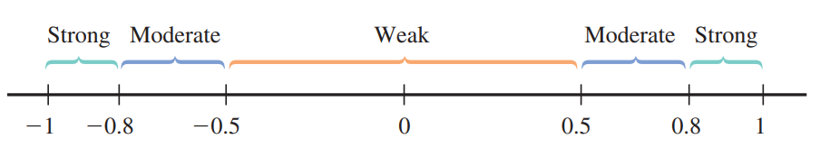
Properties of r:
The value of r does not depend on the unit of measurement for either variable.
The value of r does not depend on which of the two variables is considered x.
The value of r id between -1 and +1.
r=1 or r=-1 mean that two variables are perfectly correlated.

Slide 103
https://www.rossmanchance.com/applets/2021/guesscorrelation/GuessCorrelation.html

